Slide 2
Biblical Revelation
and
Spiritual Growth

Slide 3
Joshua 1.7-8 NIV: Be strong and very courageous.
Be careful to obey all the law my servant Moses gave you; do not turn from it to the right or to the left, that you may be successful wherever you go.
Keep this Book of the Law always on your lips; meditate on it day and night, so that you may be careful to do everything written in it.
Then you will be prosperous and successful.

Slide 4
Deuteronomy 17.18-20 NIV: When he takes the throne of his kingdom, he is to write for himself on a scroll a copy of this law, taken from that of the Levitical priests.
It is to be with him, and he is to read it all the days of his life so that he may learn to revere the LORD his God and follow carefully all the words of this law and these decrees and not consider himself better than his fellow Israelites and turn from the law to the right or to the left.
Then he and his descendants will reign a long time over his kingdom in Israel.

Slide 5
Hebrews 4.12 NIV: For the word of God is alive and active.
Sharper than any double-edged sword, it penetrates even to dividing soul and spirit, joints and marrow;
it judges the thoughts and attitudes of the heart.

Slide 6
Psalm 1.1-3 NIV: Blessed is the one who does not walk in step with the wicked or stand in the way that sinners take or sit in the company of mockers,
but whose delight is in the law of the LORD, and who meditates on his law day and night.
That person is like a tree planted by streams of water, which yields its fruit in season and whose leaf does not wither-- whatever they do prospers.

Slide 7
1 Corinthians 2.11-13 NIV: For who knows a person's thoughts except their own spirit within them? In the same way no one knows the thoughts of God except the Spirit of God.
What we have received is not the spirit of the world, but the Spirit who is from God, so that we may understand what God has freely given us.
This is what we speak, not in words taught us by human wisdom but in words taught by the Spirit, explaining spiritual realities with Spirit-taught words.

Slide 8
Psalms 119.1-12 NIV: Blessed are those whose ways are blameless, who walk according to the law of the LORD. Blessed are those who keep his statutes and seek him with all their heart--they do no wrong but follow his ways. You have laid down precepts that are to be fully obeyed. Oh, that my ways were steadfast in obeying your decrees! Then I would not be put to shame when I consider all your commands. I will praise you with an upright heart as I learn your righteous laws. I will obey your decrees; do not utterly forsake me. How can a young person stay on the path of purity? By living according to your word. I seek you with all my heart; do not let me stray from your commands. I have hidden your word in my heart that I might not sin against you. Praise be to you, LORD; teach me your decrees.

Slide 9
Psalm 119.104-105 NIV: I gain understanding from your precepts; therefore I hate every wrong path. Your word is a lamp for my feet, a light on my path.

Slide 10
John 8.31-32 NIV: To the Jews who had believed him, Jesus said, “If you hold to my teaching, you are really my disciples. Then you will know the truth, and the truth will set you free.”

Slide 11
John 8.31-32 NIV: To the Jews who had believed him, Jesus said, “If you hold to my teaching, you are really my disciples. Then you will know the truth, and the truth will set you free.”
Luke 11.28 NIV: “Blessed … are those who hear the word of God and obey it.”

Slide 12
Level 1: Listen
Level 2: Read
Level 3: Memorize
Level 4: Study
Level 5: Reflect & Apply
conviction
enlightenment
obedience
blessing
freedom
empowerment
hope
encouragement
revelation
transformation

Slide 13
John 17.17 NIV: “Sanctify them by the truth; your word is truth.”

Slide 14
John 17.17 NIV: “Sanctify them by the truth; your word is truth.”
Romans 12.2 NIV: Do not conform to the pattern of this world, but be transformed by the renewing of your mind. Then you will be able to test and approve what God's will is-- his good, pleasing and perfect will.

Slide 15
2 Timothy 3.16-17 NIV: All Scripture is God-breathed and is useful for teaching, rebuking, correcting and training in righteousness, so that the servant of God may be thoroughly equipped for every good work.

Slide 16
2 Timothy 3.16-17 NIV: All Scripture is God-breathed and is useful for teaching, rebuking, correcting and training in righteousness, so that the servant of God may be thoroughly equipped for every good work.
James 1.22 NIV: Do not merely listen to the word, and so deceive yourselves. Do what it says.

Slide 17
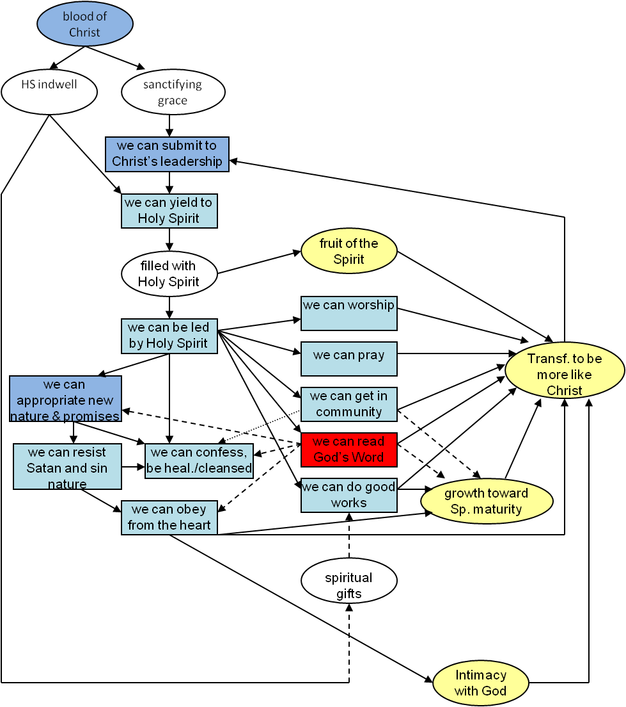
Spiritual Growth [Progressive Sanctification] Flow Chart

